Slide 1
TAS Department Subject Selection
Year 8 into 9
- Textiles
- Food Technology
- Hospitality Fundamentals
Y

Slide 2
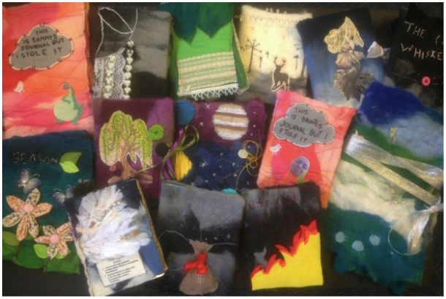
Textiles Technology (200h)
The focus of this course is on the practical aspects of textile technology topics studied include:
Apparel
Furnishings
Costume
Textile Arts
Non-apparel

Slide 3

Food Technology (200h)
Food in Australia
Food Equity
Food Product Development
Food Selection and health
Food Service and Catering
Food for Special Needs
Food for Special Occasions
Food Trends

Slide 4
Hospitality Fundamentals + Certificate I
Year 9 Course – From the FT Syllabus
Year 10 Course
Nutrition
Food Selection and Health
Food Service and Catering
Food for Special Occasions
Prepare and serve espresso coffee
Prepare sandwiches
Use Food Preparation equipment
Use hygienic practices for food safety
Participate in safe work practices
Provide information and assistance
Work effectively with others

Slide 5
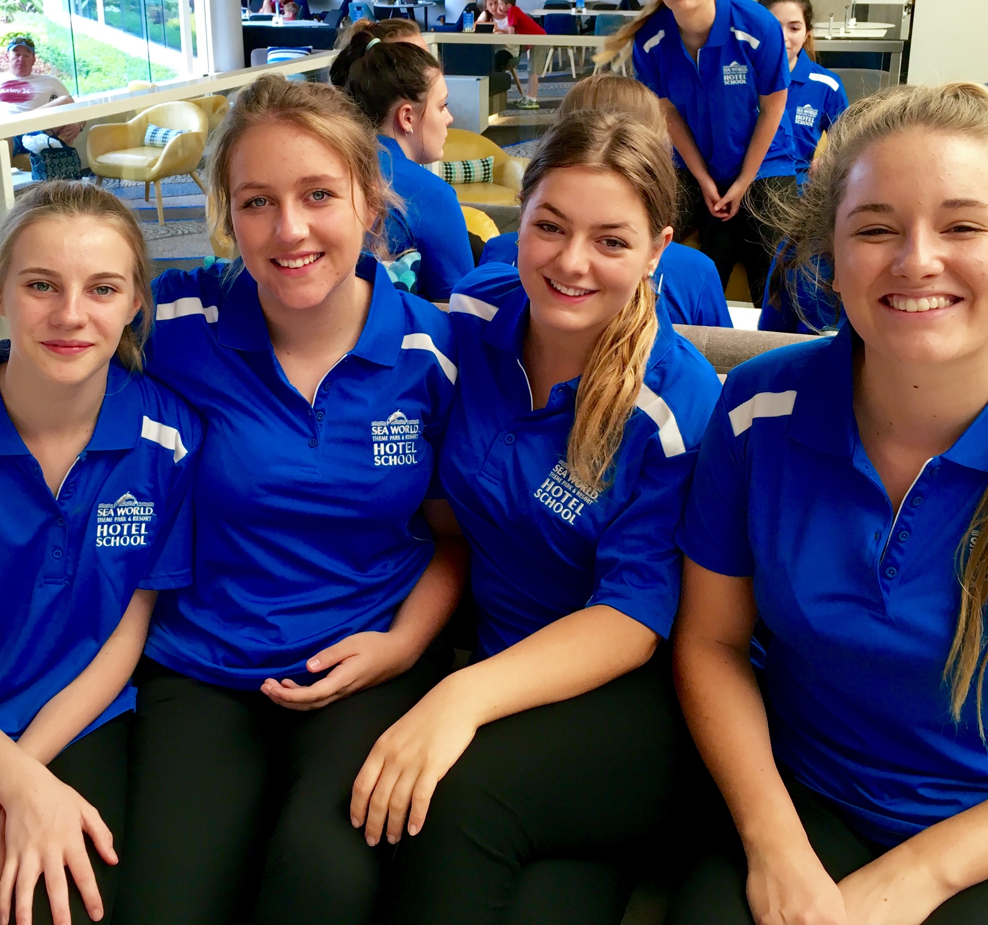
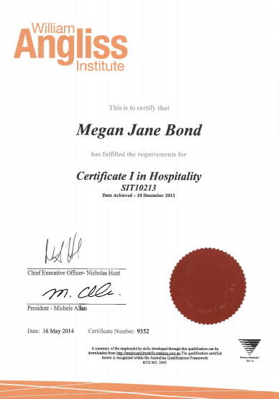
Certificate I – Hospitality
Seaworld – Hotel School Work Experience in Year 10
You work to attain the following qualification issued by BOSTES

